Slide 1
Social MEDIA ENGAGEMENT
Roxann Bowley
Data 110
Professor Rebin Muhammad

Slide 2
Introduction
Focus: Analyzing engagement across TikTok, Instagram, Twitter, YouTube
Goal: Understand engagement patterns and platform/regional performance
Research Questions:
How is the distribution of likes over platforms?
What is the variability in engagement level in these platforms?
In what way does engagement vary by region?
What is the relationship between likes, shares, and comments?
Notes:
This presentation explores user engagement across major social media platforms. The goal is to evaluate how interactions like likes, shares, and comments vary, and to identify platform and regional trends. The research is guided by four questions focused on likes distribution, platform engagement levels, multi-metric relationships, and regional differences.

Slide 3
Data description
Platforms: TikTok, Instagram, Twitter, YouTube
Metrics: Likes, Shares, Comments, Engagement Level
Engagement Levels: High, Medium, Low
Regions: USA, Canada, UK, Brazil, India, Australia, Japan, Germany
Data Source: https://www.kaggle.com/code/morpho23/from-cluster-to-conclusion/input
Notes:
The dataset includes user interaction data from four platforms, categorized by likes, shares, and comments. Posts are classified into three engagement levels. The data is also broken down by eight global regions, enabling regional comparative analysis.

Slide 4
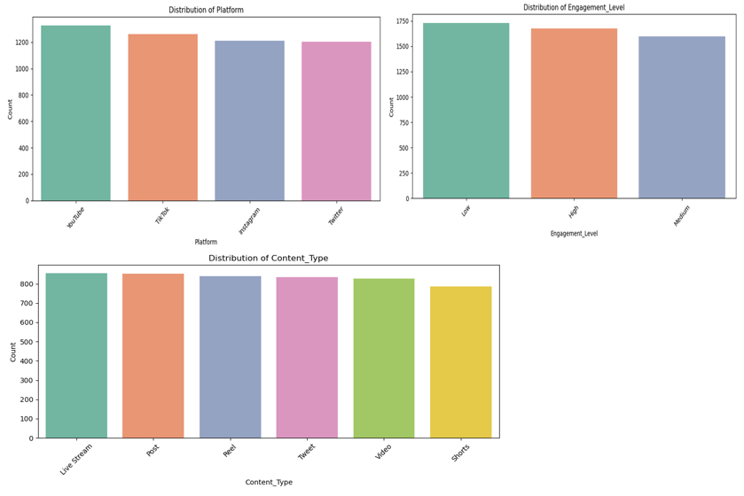
E.d.a
Notes:
The EDA reveals a balanced presence across platforms, with YouTube having a slight edge in viral post frequency. Content types like Live Streams, Reels, and Shorts are fairly evenly distributed, indicating varied content strategies. Engagement analysis shows more posts fall under High or Low engagement than Medium, suggesting that content tends to either strongly resonate with users or struggle to gain traction.

Slide 5
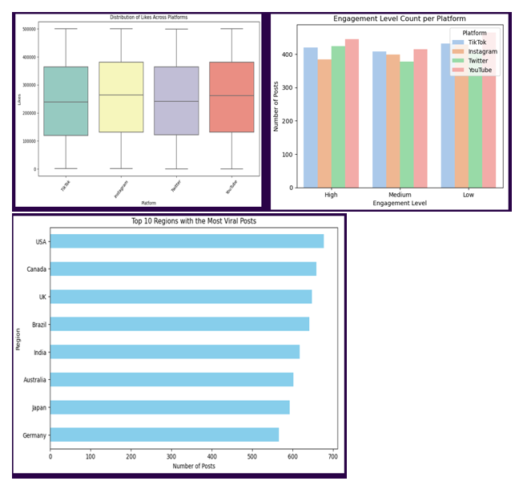
Platforms vs Engagement
Likes are evenly distributed across platforms
Engagement levels consistent among platforms
YouTube slightly higher in high-engagement posts
USA tops number of viral post
Notes:
Boxplots reveal a relatively even distribution of likes among the four platforms. A stacked bar chart shows engagement levels are mostly balanced, though YouTube has a slightly higher proportion of high-engagement posts, suggesting greater consistency in its content performance. USA was found to be the region with the most viral posts, followed by Canada and the United Kingdom.

Slide 6
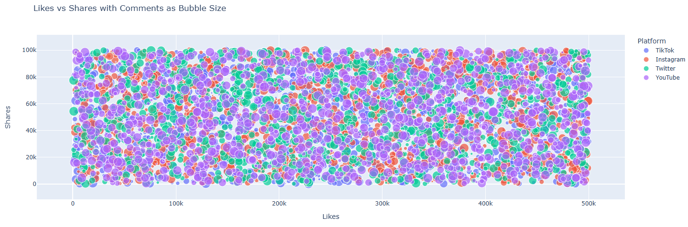
Likes vs Shares with Comments Bubble Chart
Positive trend between likes and shares
Comment volume visualized via bubble size
TikTok and YouTube dominate high-comment posts
Notes:
This bubble chart shows that while there is a general upward trend between likes and shares, the correlation is weak. Bubble sizes represent comments, revealing that TikTok and YouTube have more posts with large comment volumes, indicating richer user interaction.

Slide 7
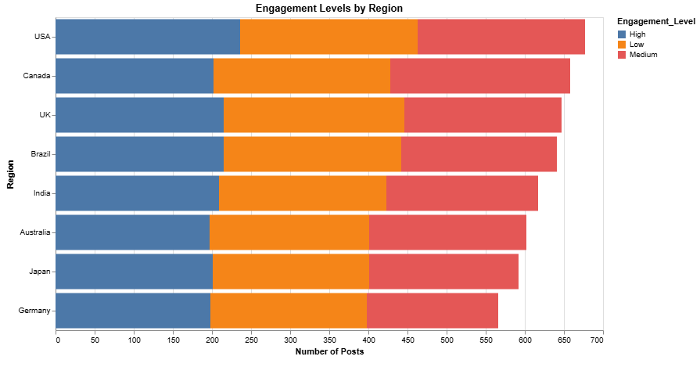
Engagement Levels by Region
USA and Canada lead in high engagement
Other regions show a mix of medium and low levels
Highlights geographic disparity in engagement
Notes:
The stacked bar chart demonstrates significant regional variation. USA and Canada exhibit the highest number of high-engagement posts. Meanwhile, countries like Japan and Germany have more medium and low engagement, suggesting the need for region-specific strategies.

Slide 8
Conclusion
Likes are evenly spread across platforms
YouTube posts show higher high-engagement consistency
Engagement is multi-dimensional; comments vary widely
USA and Canada outperform other regions in engagement
Notes:
In conclusion, social media engagement is not solely dependent on platform popularity. While all platforms show similar like distributions, YouTube edges ahead in engagement quality. The relationship between likes, shares, and comments is complex and non-linear. Most importantly, regional analysis reveals that the USA and Canada have higher engagement levels, which should inform future content strategies.

Slide 9
Thank you

